Slide 1
Flow of control in C++: Selection structures and loops
CPSC 2320 L1
2020-09-10

Slide 2
Lecture outline
Flow of control
Selection structures
If-else, switch-case
Repetition statements
For, while, do-while

Slide 3
Selection Structure
Choose which statement to be executed next based on a condition
You’ve seen this before
If-else

Slide 4
In C++
if (expression)
{
//code if expression==true
}
else if (second expression)
{
//code
}
else
{
//if none of the above
}

Slide 5
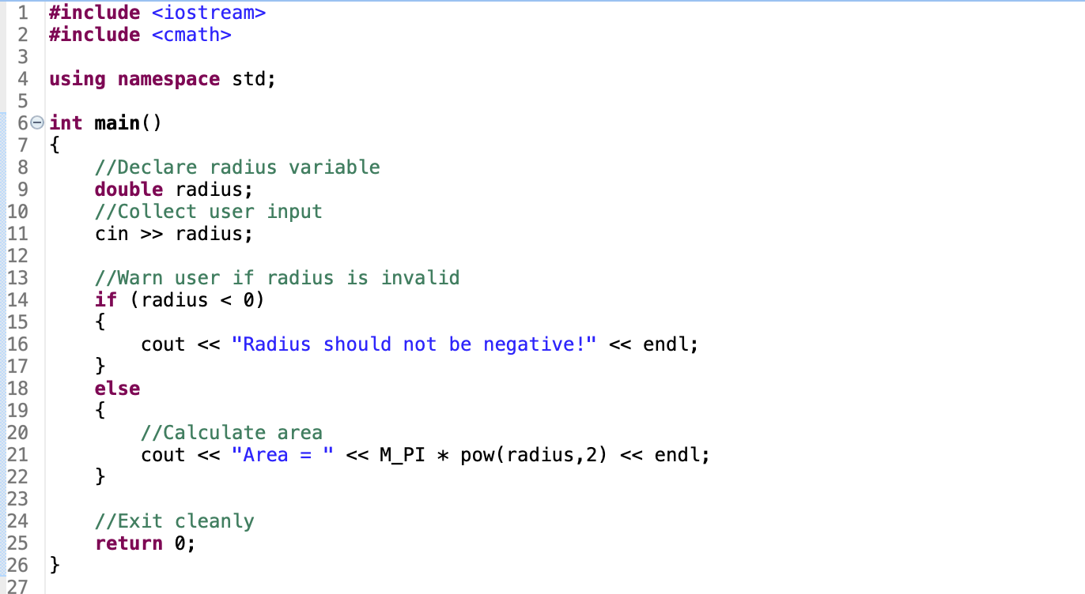
Example

Slide 6
In C++
if (expression1)
{
//code if expression==true
}
else if (expression2) //only evaluated if expression1 evaluates false
{
//code
}
else //only evaluated if none of the above evaluates true
{
//if none of the above
}

Slide 7
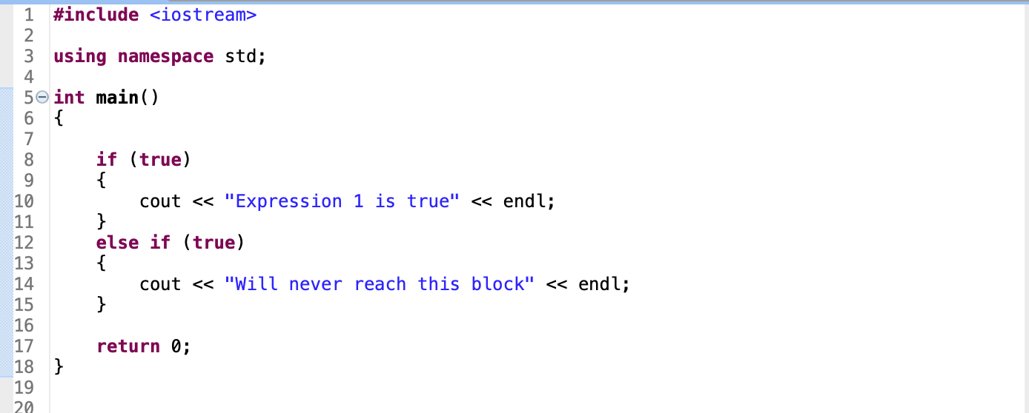
Example 2

Slide 8
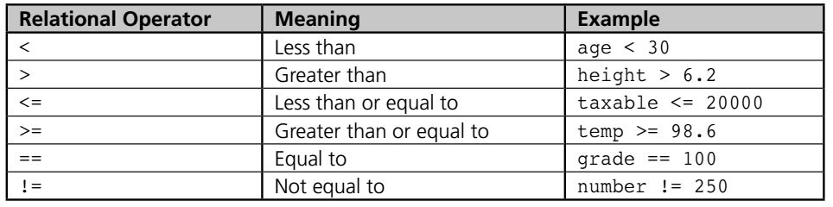
Relational operators in C++

Slide 9
Relational operators in C++
Relational operators return an integer: 0 or 1
0→false, 1→true

Slide 10
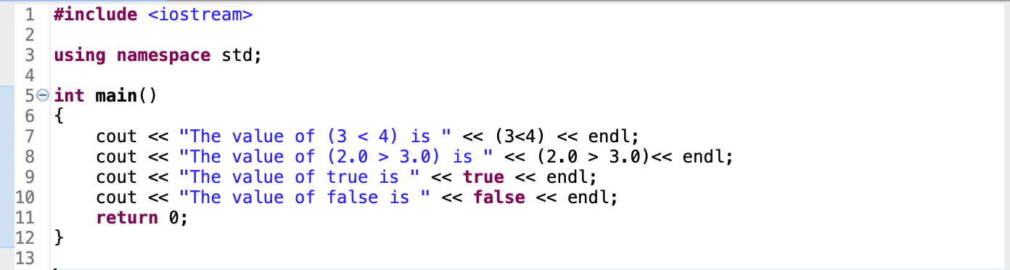
Example
The value of (3 < 4) is 1
The value of (2.0 > 3.0) is 0
The value of true is 1
The value of false is 0

Slide 11
Logical operators
Can combine many relational expressions
AND (&&)
Evaluate true if and only if each individual expression evaluates true
OR (||)
Evaluates true if any of the expressions evaluate true
NOT (!)
Evaluates true if expression is false, false if expression is true

Slide 12
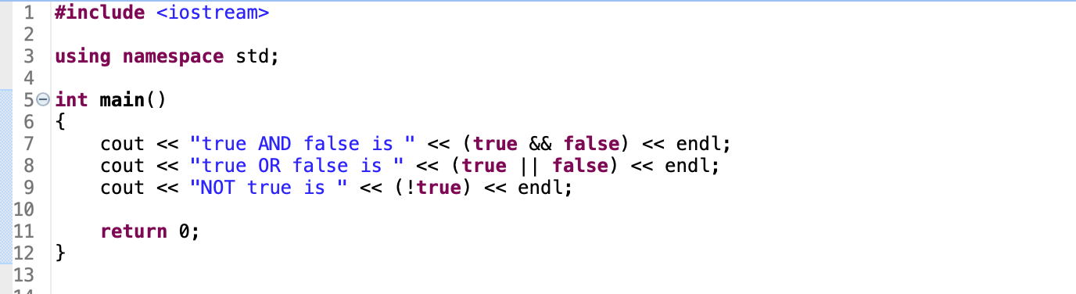
Logical Operators
true AND false is 0
true OR false is 1
NOT true is 0

Slide 13
LOGICAL OPERATORS
if ( (expr1) && (expr2) && (expr3) )
{
//if all 3 expressions are true
}
if ( ( (expr1) && (expr2) ) || (expr3) )
{
//if both 1 and 2 are true,
//OR if 3 is true
}

Slide 14
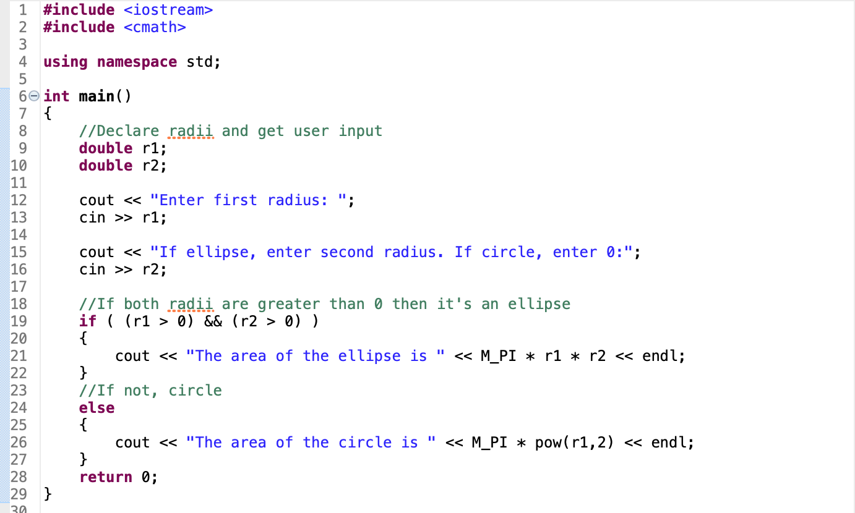
ExaMPLE

Slide 15
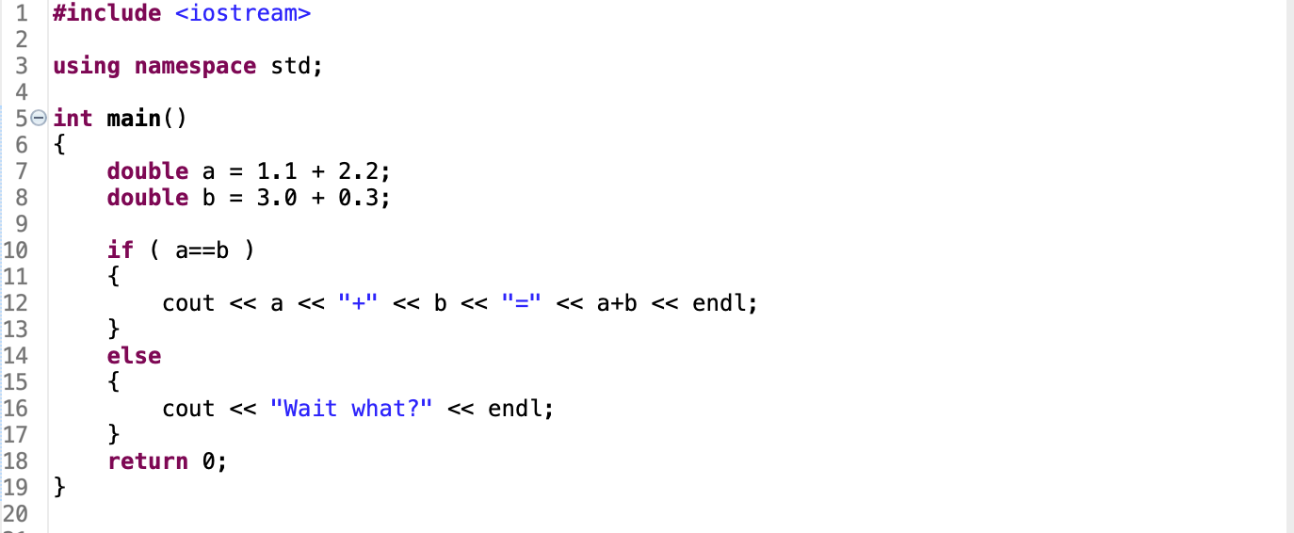
Be Careful!
Computers cannot represent (most) floats exactly
Subject to errors in equality evaluation

Slide 16
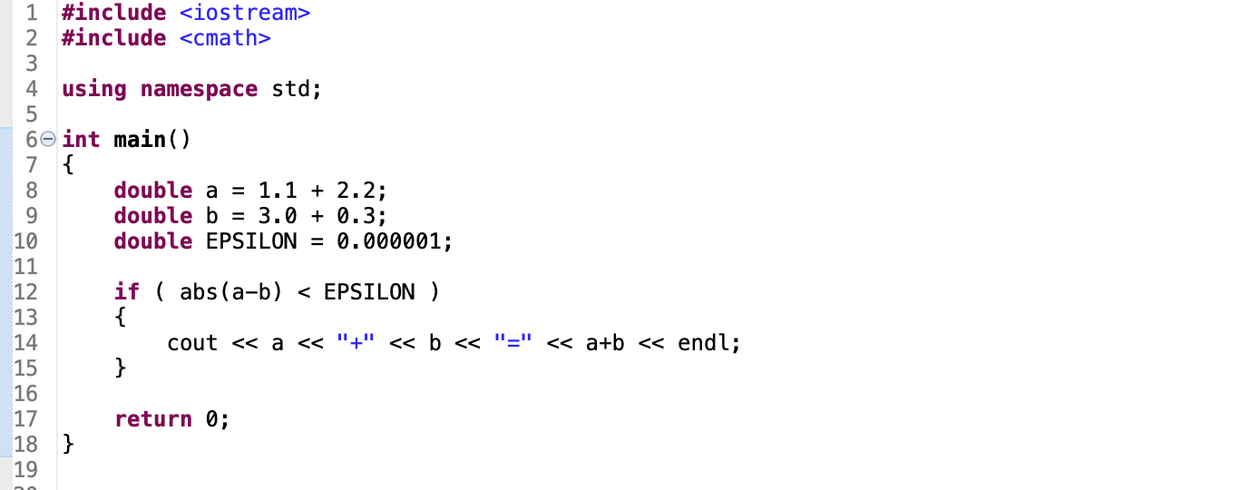
Better…

Slide 17
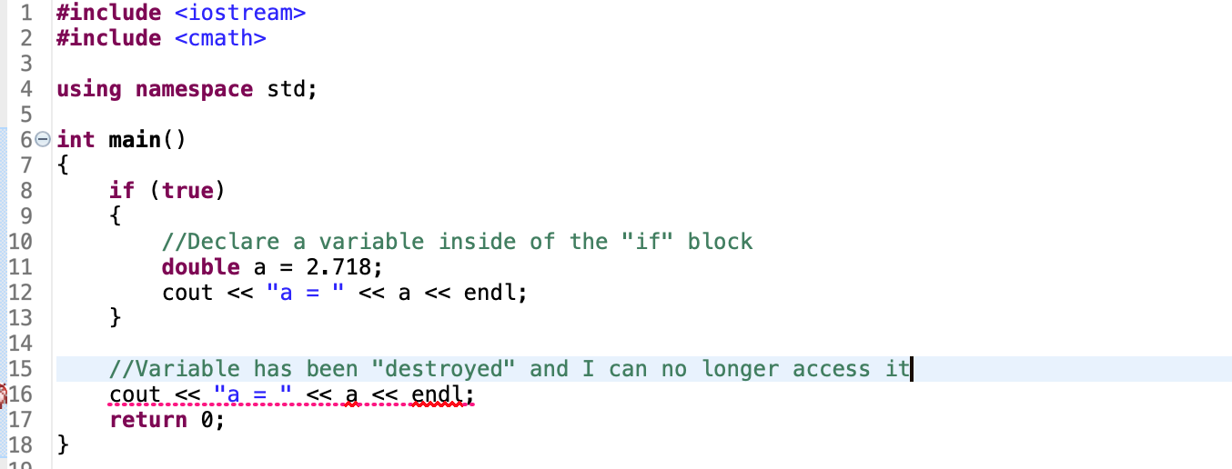
A Note on Variable Scope

Slide 18
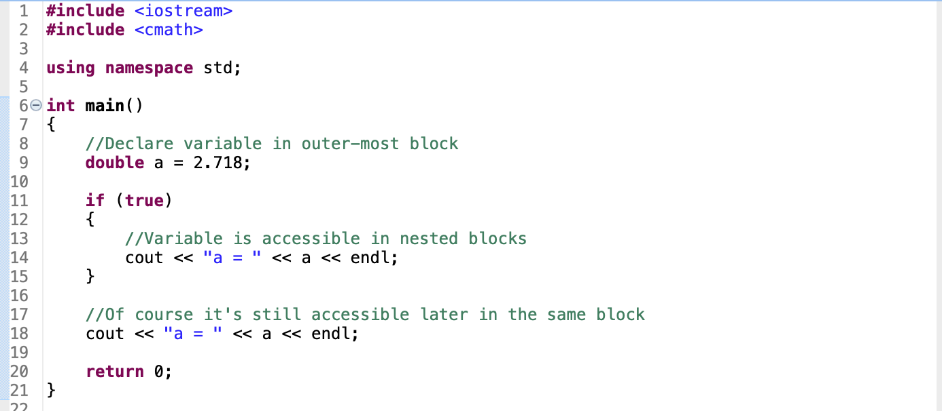
A Note on Variable Scope

Slide 19
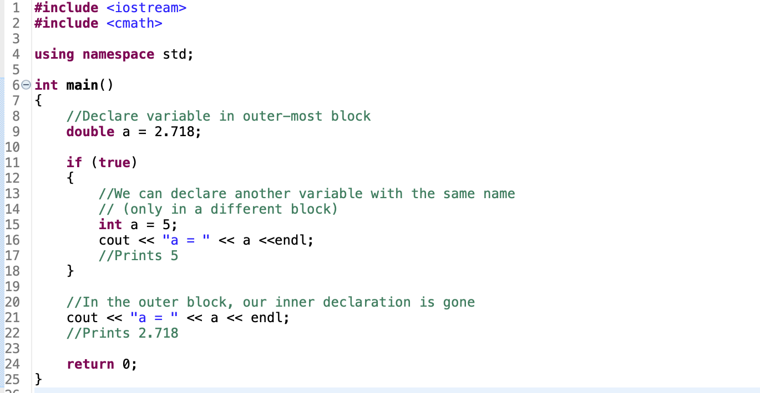
A note on variable scope

Slide 20
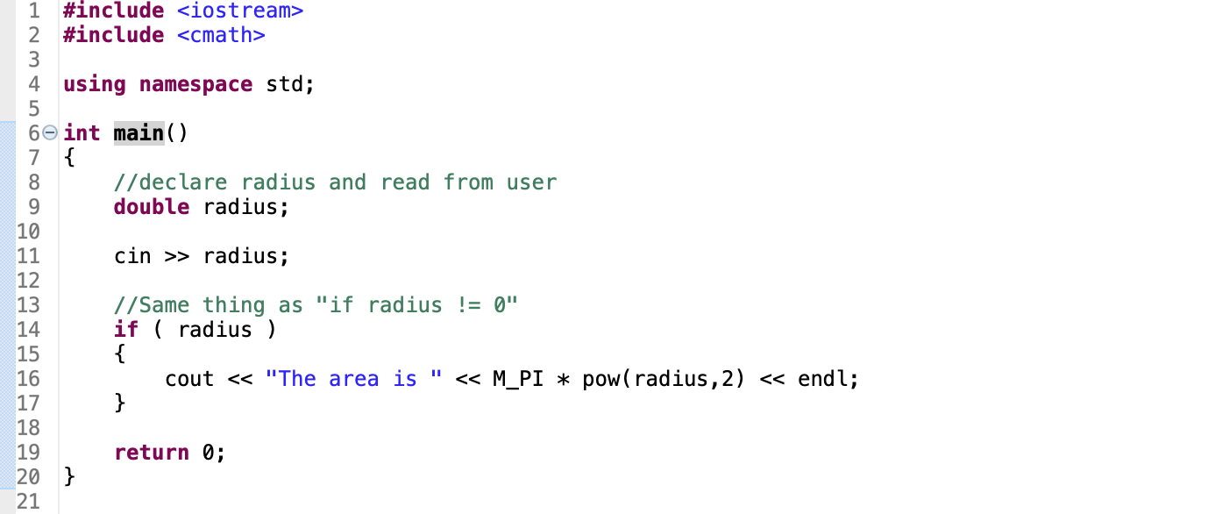
Any non-zero expression IS “true”

Slide 21
Nested If statements
if (expression1)
{
if (expression2)
{
do stuff
}
}

Slide 22
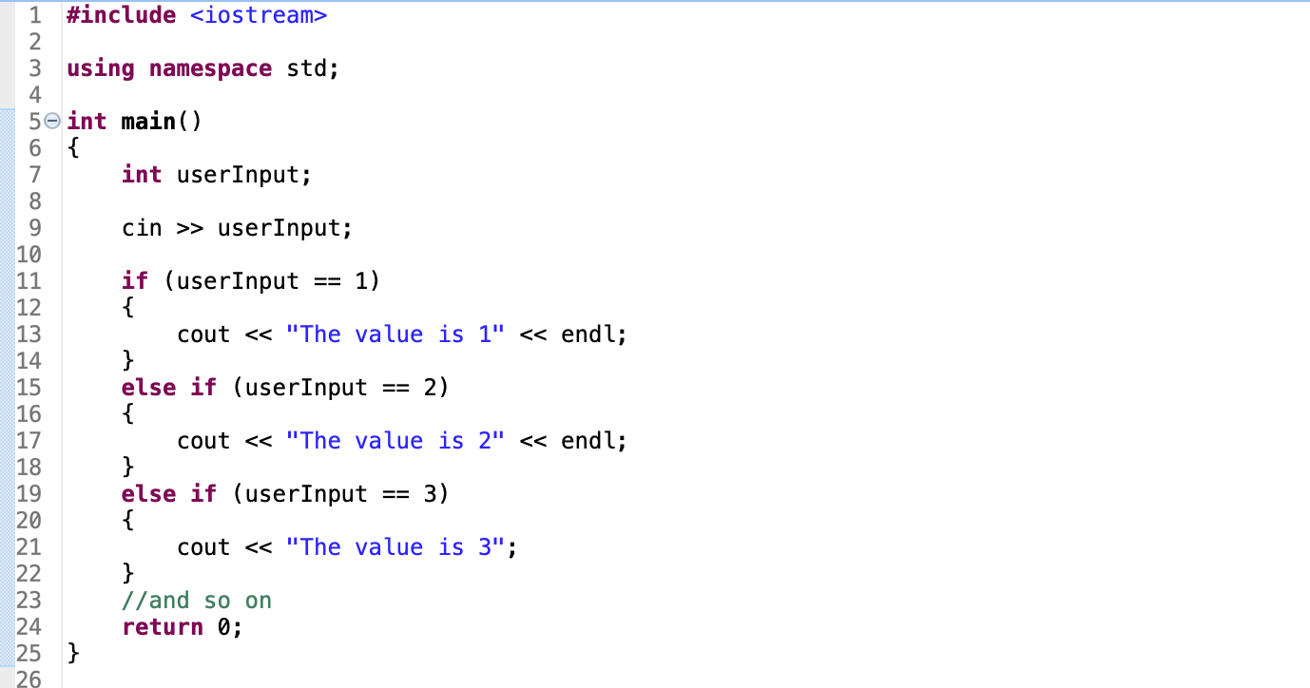
Switch/Case: A replacement for long if/else statements

Slide 23
Switch/Case: A replacement for long if/else statements
switch (intVar)
{
case 1: //if intVar==1
run this code;
break;
case 2: //intVar==2
run this other code;
break;
default: //None of the above
run code here
}

Slide 24
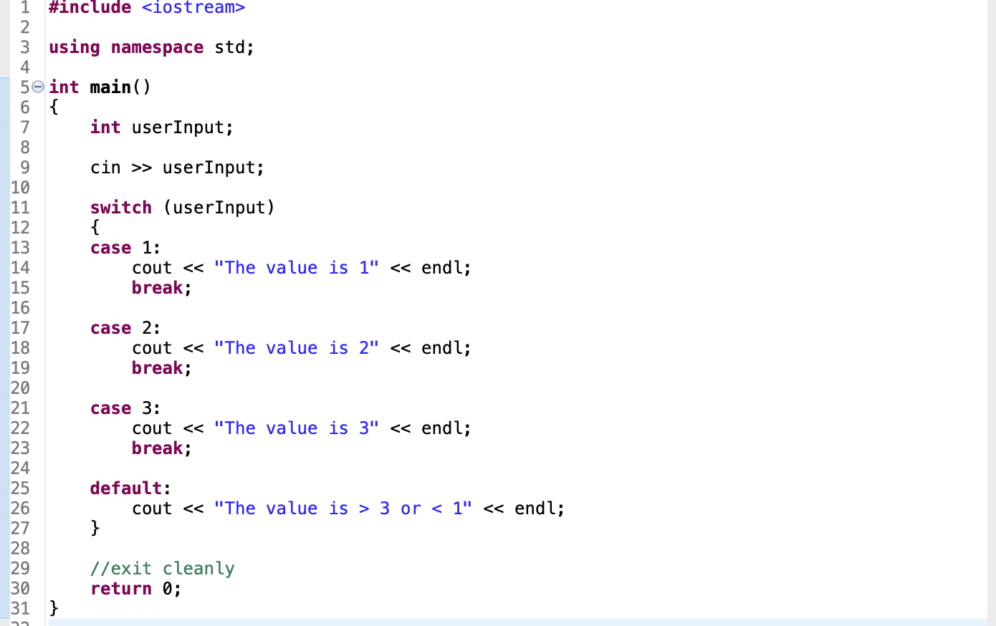
Switch/Case: A replacement for long if/else statements
Evaluate multiple “cases” for a integer variable

Slide 25
BREAK
Finish installing Eclipse and C++ compiler
Work on Lab 1, part 1

Slide 26
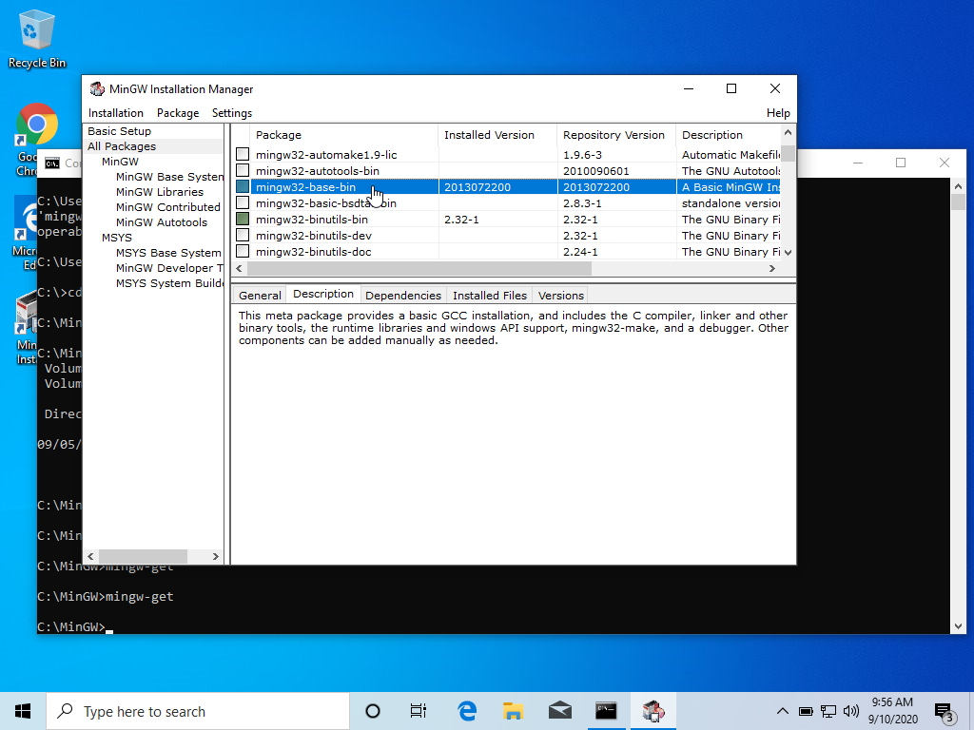
On Windows Command prompt: cd \MinGW\bin
run “mingw-get”
Check “mingw32-base-bin”
Installation >> Apply Changes

Slide 27
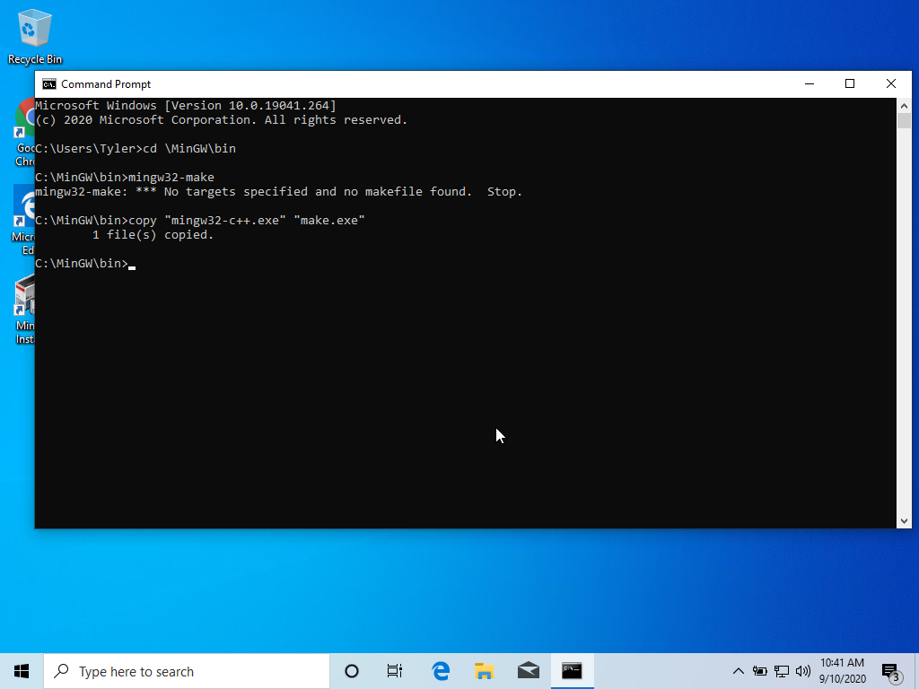
On command prompt: cd \MinGW\bin
Run mingw32-make
Should see “No targets specified” etc
This is good
Type: copy “mingw32-make.exe” “make.exe”
Enter
Run make
Should see same message as before

Slide 28
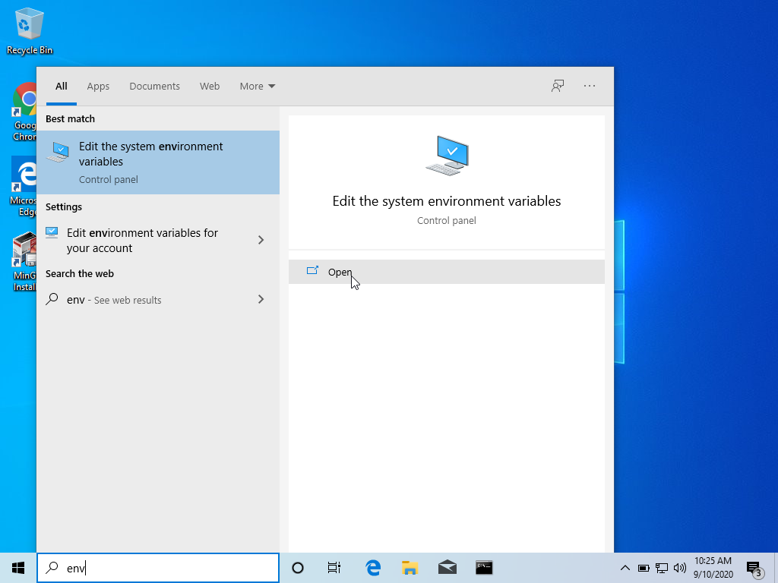
Now we will add C:\MinGW\bin to our ”Path” so Eclipse knows how to find it
Go to “Edit the system environment variables”
Easiest way: just type “env” in the launch menu

Slide 29
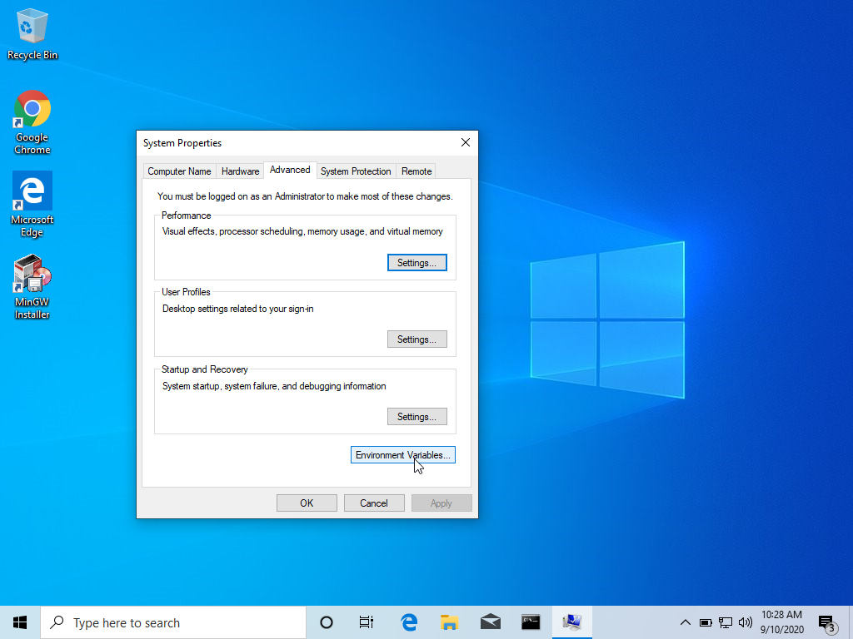
Choose “Environment Variables”

Slide 30
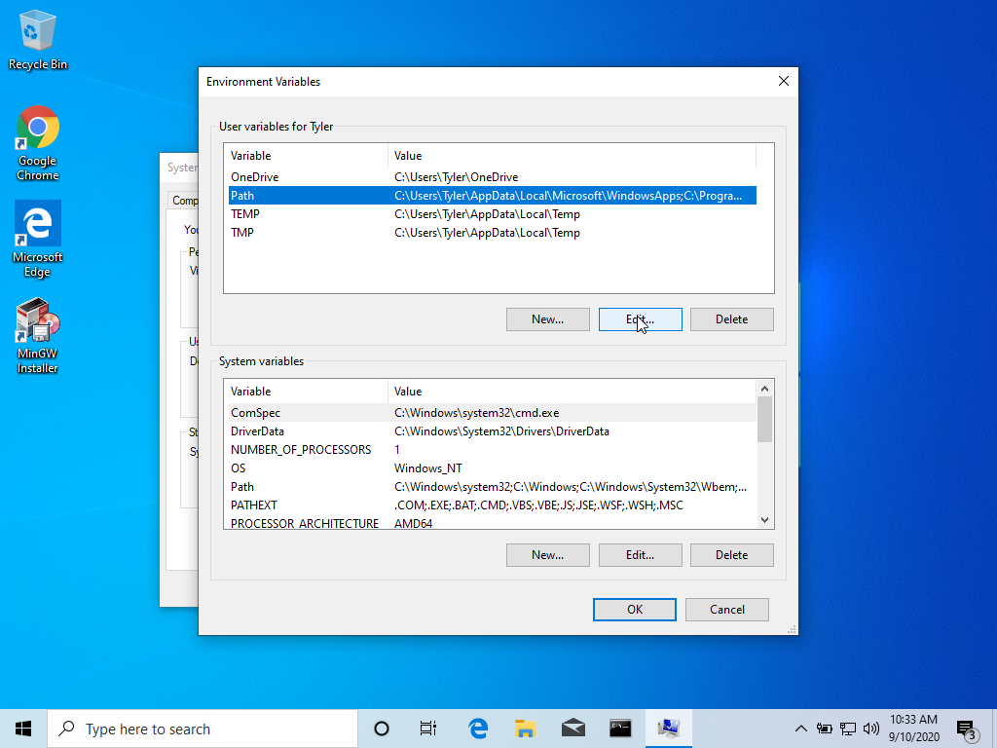
Select Path
Edit

Slide 31
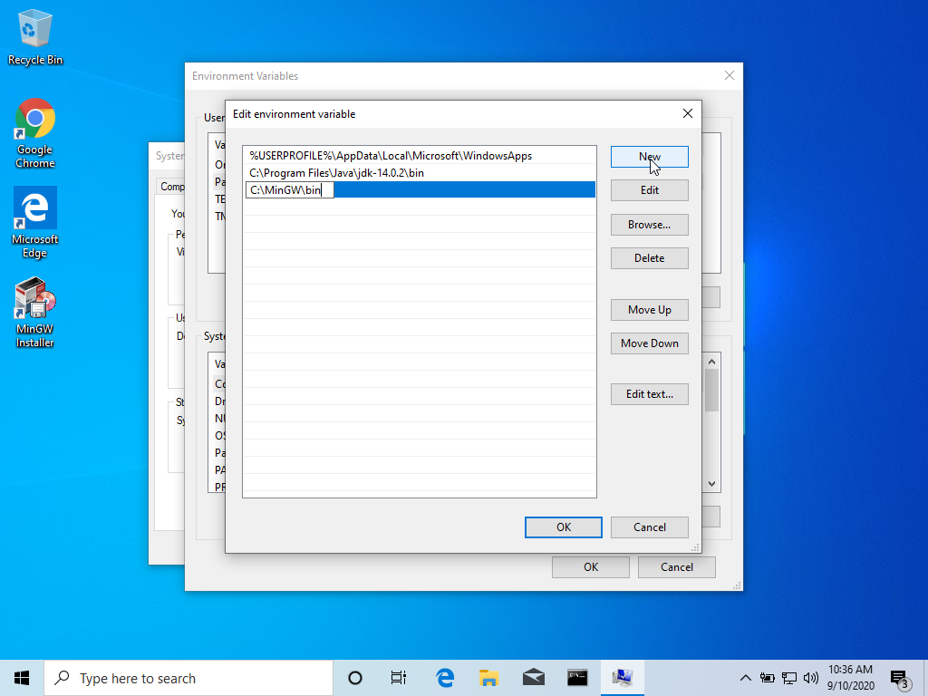
New
Type “C:\MinGW\bin”
“OK” in all open menus

Slide 32
Close and reopen command prompt
cd \
Type make
Should see “No targets specified” …

Slide 33
Build a new Eclipse project (start with a simple hello world)
Instructions for this starting at slide 38 from lasts week’s slides:

Slide 34
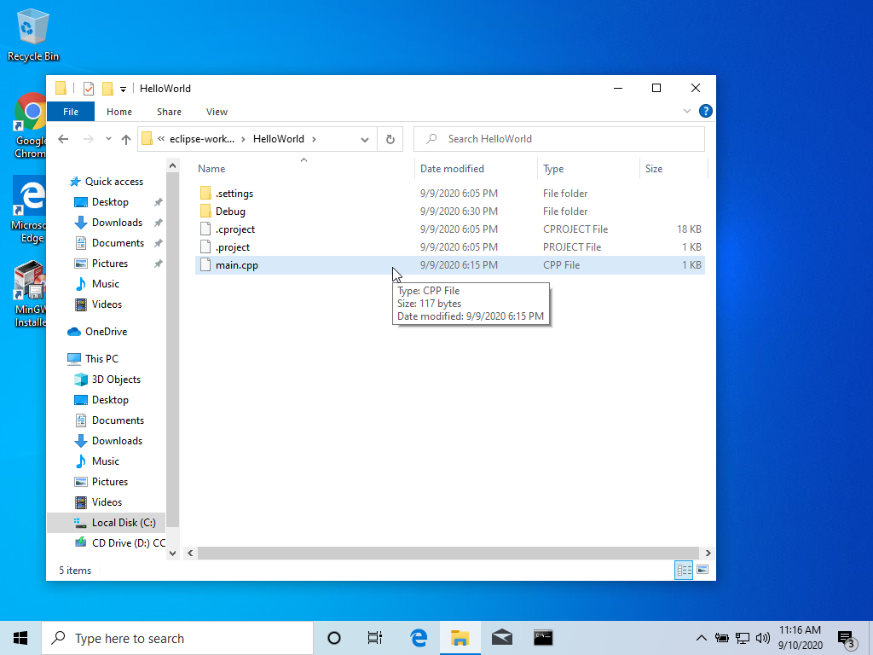
Where is my source file?
If you are editing a cpp source file and want to upload it
Find your eclipse-workspace folder
It’s in C:\Users\<username>, unless you changed it
Click on the folder named after your project
You should see the cpp file there

Slide 36
Repetition Statements
Repeat an action while a condition remains true
When is the condition evaluated?
Before the code block = “pre test”
After the code block = “post test”

Slide 37
Repetition Statements
Repeat for a pre-determined number of iterations? (fixed-count loop)
for i in range(num)
Continue looping until condition is met? (variable-condition loop)
while (stopLoop==False)

Slide 38
While loop
while (condition)
{
run looped code
}
//this code executed afterwards

Slide 39
While Loop
Test the expression
If expression evaluates true:
Execute blocked code
Go back to (1)
If expression evaluates false:
Skip blocked code and proceed to next statement after loop

Slide 40
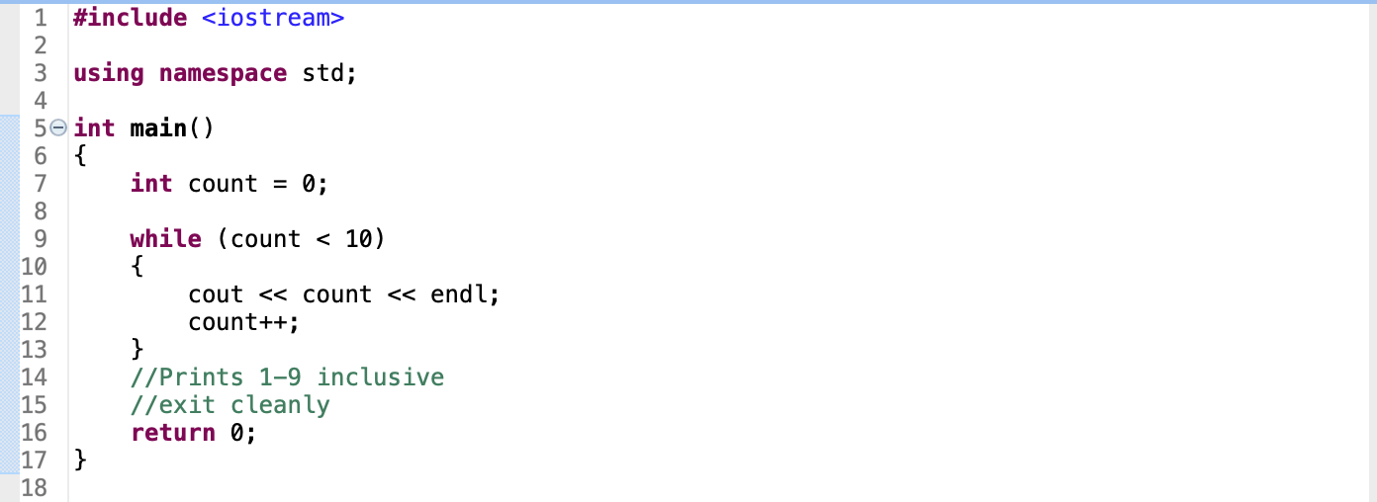
Example

Slide 41
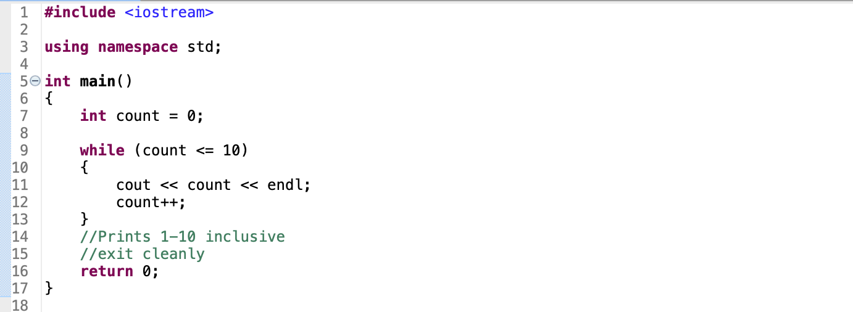
Example

Slide 42
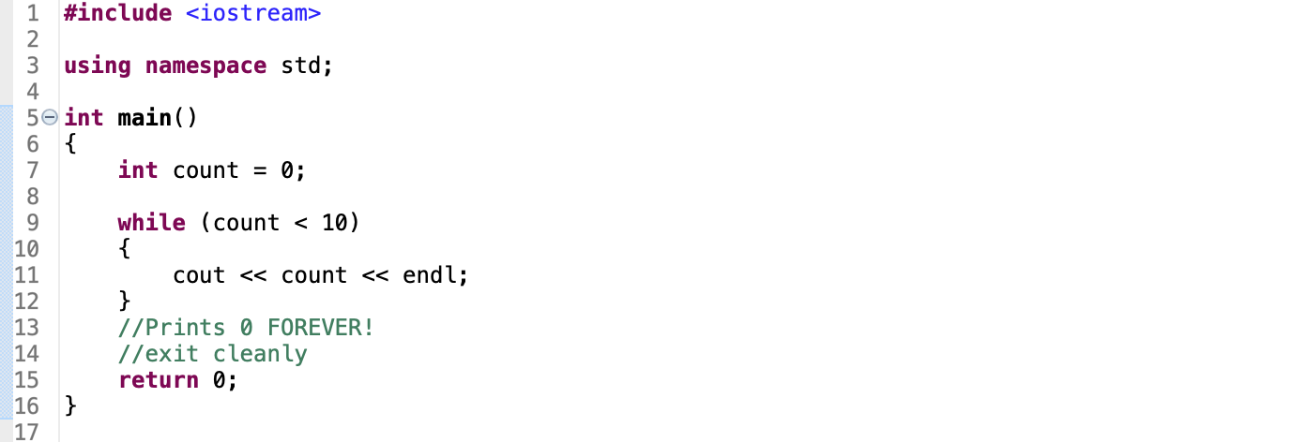
WARNING: Infinite loops!

Slide 43
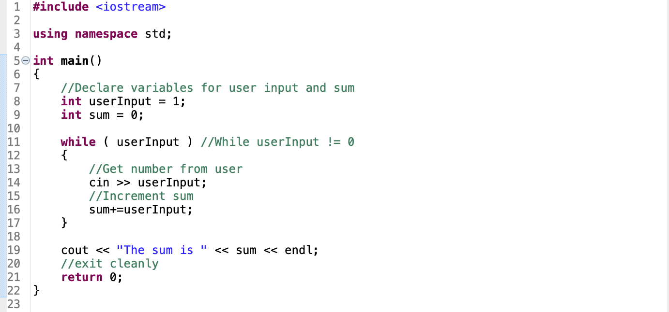
Another Example

Slide 44
For Loops
for (initialization; relational expression; increment)
{
run looped code
}
//this code executed afterwards

Slide 45
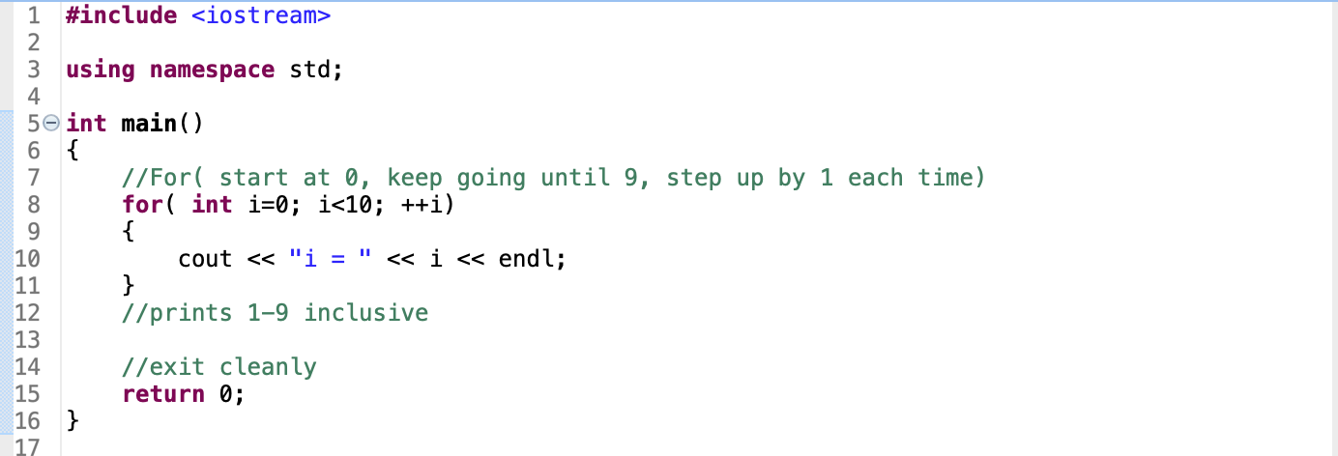
Example

Slide 46
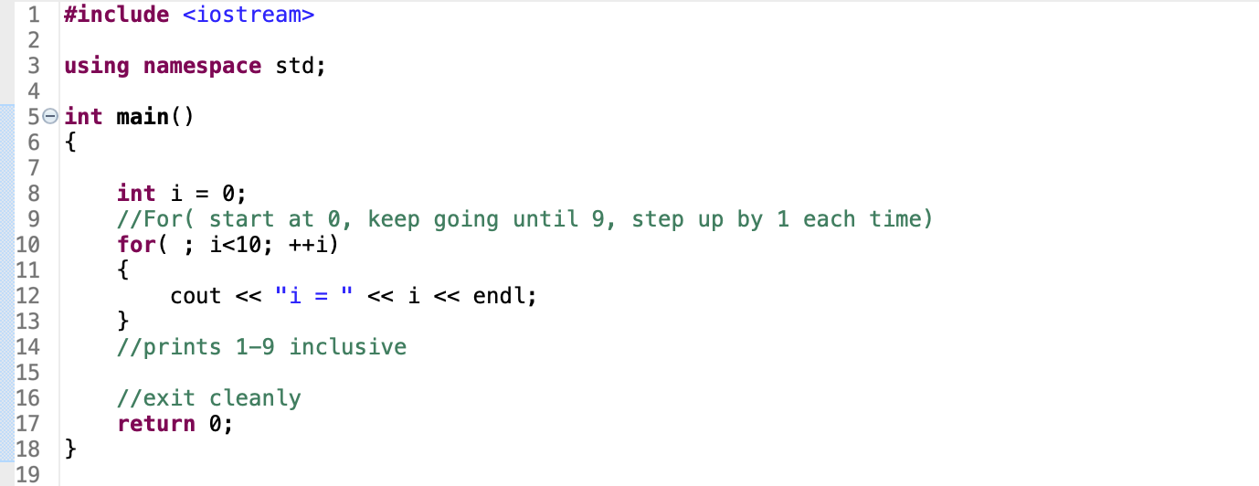
Example

Slide 47
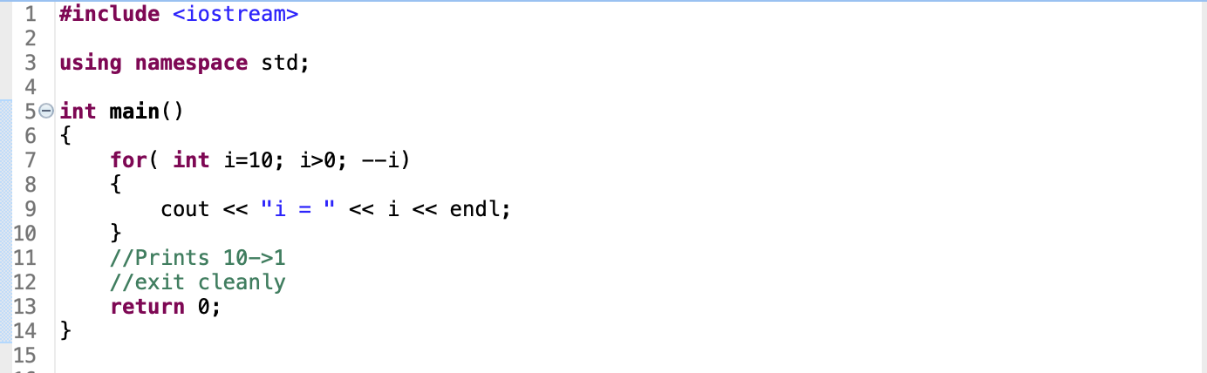
Looping Backwards

Slide 48
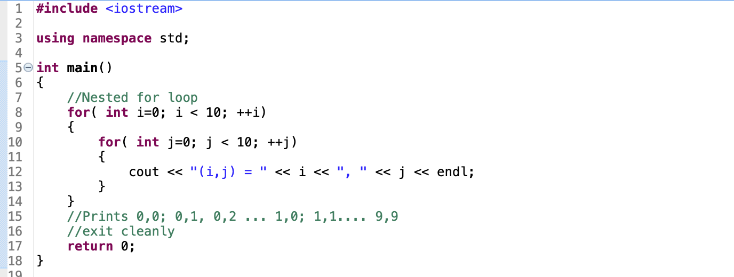
Nested Loops

Slide 49
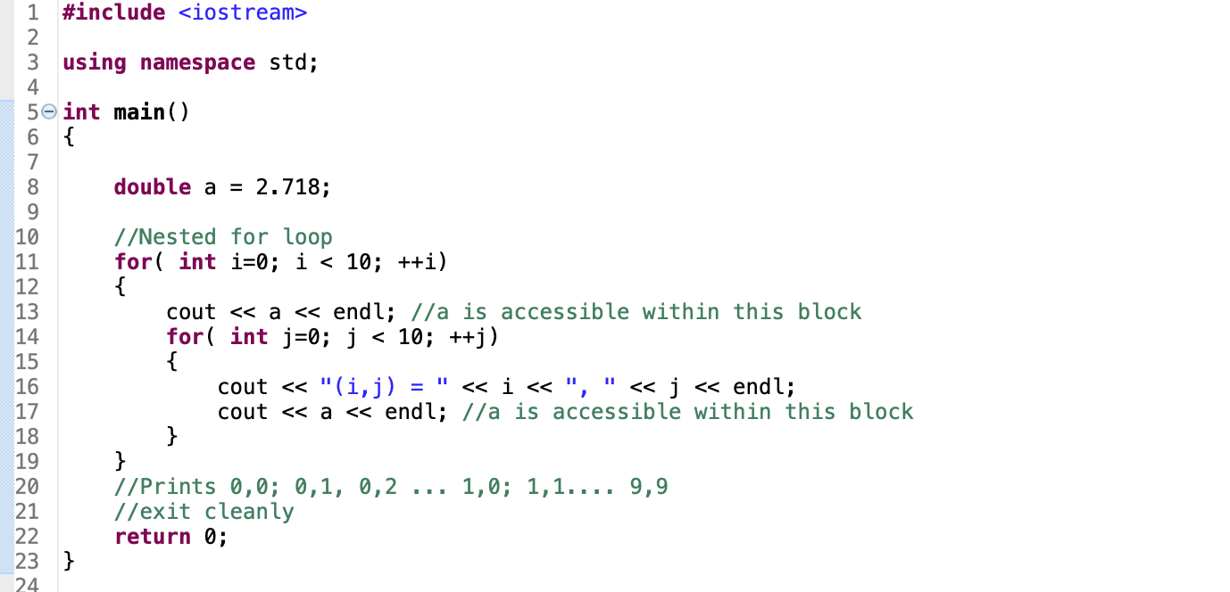
Scope

Slide 50
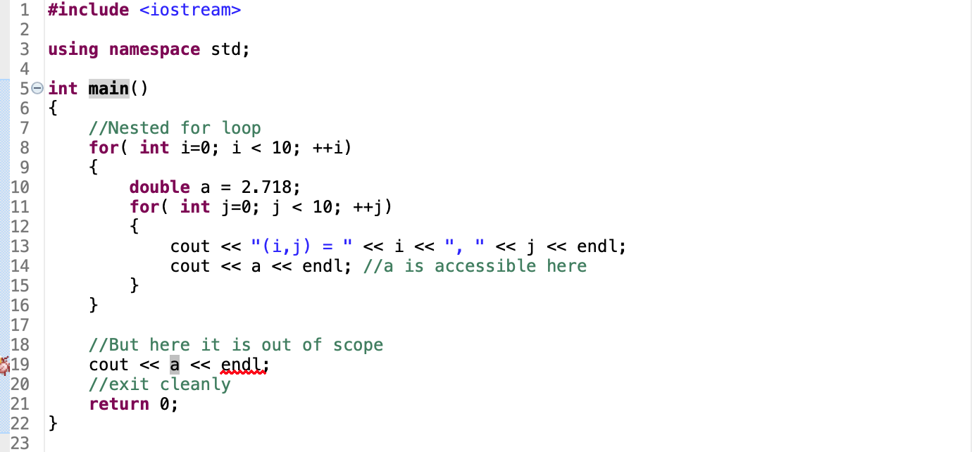
Scope

Slide 51
Do-While Loops
Just like while loops, except condition is checked after

Slide 52
DO-While Loops
do
{
looped code here
}
while(condition);

Slide 53
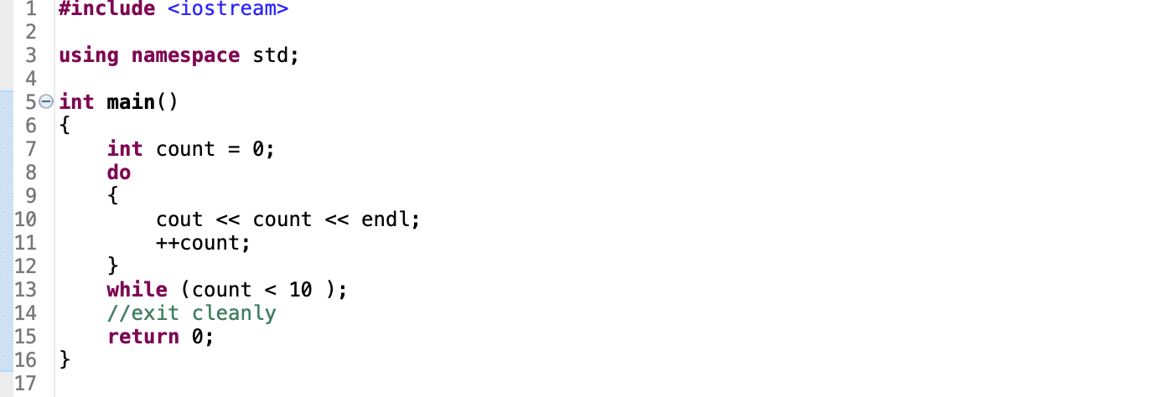
Do-While Loops

Slide 54
Break and Continue
Break
Exit the loop completely and proceed to next statement outside of loop
Continue
Skip the rest of this particular loop iteration, and continue to the next iteration

Slide 55
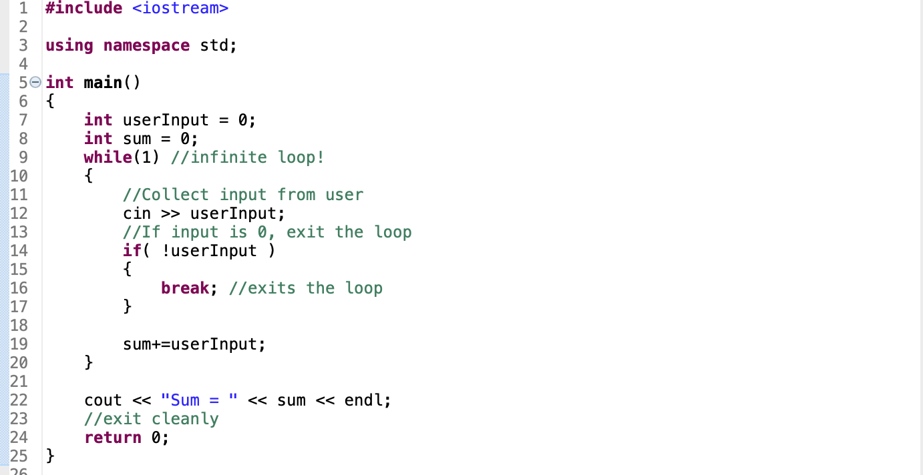
Break Statement

Slide 56
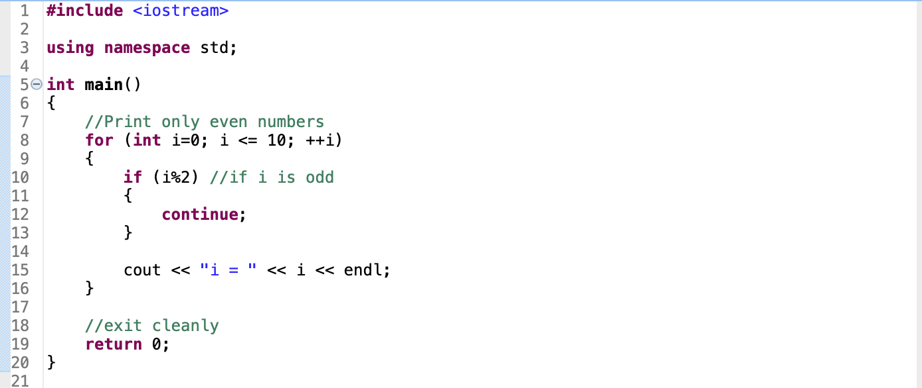
Continue Statement

Slide 57
Fin
Finish Lab 1 in class or take it home. Due Tuesday night via Canvas.

